Slide 1
CSE115/ENGR160 Discrete Mathematics
04/17/12
Ming-Hsuan Yang
UC Merced

Slide 2
6.3 Permutations & Combinations
Counting:
  Find out the number of ways to select a particular number of elements from a set
  Sometimes the order of these elements matter
Example:
  How many ways we can select 3 students from a group of 5 students?
  How many different ways they stand in line for picture?

Slide 3
Permutation
How many ways can we select 3 students from a group of 5 to stand in lines for a picture?
First note that the order in which we select students matters
There are 5 ways to select the 1st student
Once the 1st student is selected, there are 4 ways to select the 2nd student in line. By product rule, there are 5x4x3=60 ways to select 3 student from a group of 5 students to stand line for picture

Slide 4
Permutation
How many ways can we arrange all 5 in a line for a picture?
By product rule, we have 5x4x3x2x1=120 ways to arrange all 5 students in a line for a picture

Slide 5
Permutation
A permutation of a set of distinct objects is an ordered arrangement of these objects
An ordered arrangement of r elements of a set is called an r-permutation
The number of r-permutation of a set with n element is denoted by P(n,r). We can find P(n,r) using the product rule
Example: Let S={1, 2, 3}. The ordered arrangement 3, 1, 2 is a permutation of S. The ordered arrangement 3, 2, is a 2-permutation of S

Slide 6
Permutation
Let S={a, b, c}. The 2-permutation of S are the ordered arrangements, a, b; a, c; b, a; b, c; c, a; and c, b
Consequently, there are 6 2-permutation of this set with 3 elements
Note that there are 3 ways to choose the 1st element and then 2 ways to choose the 2nd element
By product rule, there are P(3,2)=3 x 2 = 6

Slide 7
r-permutation
Theorem 1: If n is a positive and r is an integer with 1≤r≤n, then there are
P(n,r)=n(n-1)(n-2)…(n-r+1)
r-permutations of a set with n elements
Proof: Use the product rule, the first element can be chosen in n ways. There are n-1 ways to chose the 2nd element. Likewise, there are n-2 ways to choose 3rd element, and so on until there are exactly n-(r-1)=n-r+1 ways to choose the r-th element. Thus, there are n∙(n-1)∙(n-2)… ∙(n-r+1) r-permutations of the set

Slide 8
r-permutation
Note that p(n,0)=1 whenever n is a nonnegative integer as there is exactly one way to order zero element
Corollary 1: If n and r are integers with 0≤r≤n, then P(n,r)=n!/(n-r)!
Proof: When n and r are integers with 1≤r≤n, by Theorem 1 we have
P(n,r)=n(n-1)…(n-r+1)=n!/(n-r)!
As n!/(n-0)!=1 when n is a nonnegative integer, we have P(n,r)=n!/(n-r)! also holds when r=0

Slide 9
r-permutation
By Theorem 1, we know that if n is a positive integer, then P(n,n)=n!
Example: How many ways are there to select a 1st prize winner, a 2nd prize winner, and a 3rd prize winner from 100 different contestants?
P(100,3)=100x99x98=970,200

Slide 10
Example
How many permutations of the letters ABCDEFGH contain string ABC?
As ABC must occur as a block, we can find the answer by finding the permutations of 6 letters, the block ABC and the individual letters, D,E,F,G, and H. As these 6 objects must occur in any order, there are 6!=720 permutations of the letters ABCDEFGH in which ABC occurs in a block

Slide 11
Combinations
How many different committees of 3 students can be formed from a group of 4 students?
We need to find the number of subsets with 3 elements from the set containing 4 students
We see that there are 4 such subsets, one for each of the 4 students as choosing 4 students is the same as choosing one of the 4 students to leave out of the group
This means there are 4 ways to choose 3 students for the committee, where th order in which these students are chosen does not matter

Slide 12

r-combination
An r-combination of elements of a set is an unordered selection of r elements from the set
An r-combination is simply a subset of the set with r elements
Denote by C(n,r). Note that C(n,r) is also denoted by and is called a binomial coefficient

Slide 13
Example
Let S be the set {1, 2, 3, 4}. Then {1, 3, 4} is a 3-combination from S
We see that C(4,2)=6, as the 2-combination of {a, b, c, d} are 6 subsets {a, b}, {a, c}, {a, d}, {b, c}, {b, d}, and {c, d}

Slide 14
r-combination
We can determine the number of r-combinations of a set with n elements using the formula for the number of r-permutations of a set
Note that the r-permutations of a set can be obtained by first forming r-combinations and then ordering the elements in these combinations

Slide 15
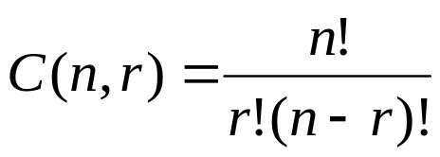
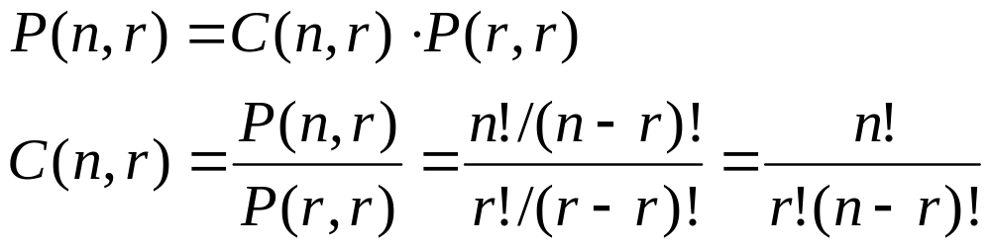
r-combination
The number of r-combinations of a set with n elements, where n is a nonnegative integer and r is an integer with 0≤r≤n equals
Proof: The r-permutations of the set can be obtained by forming the C(n,r) r-combinations and then ordering the elements in each r-permutation which can be done in P(r,r) ways

Slide 16
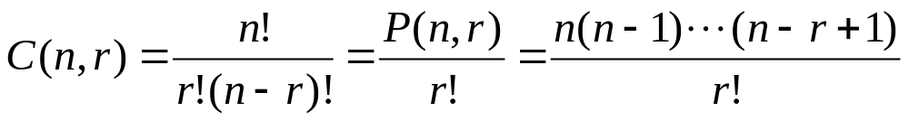
r-combination
When computing r-combination
thus canceling out all the terms in the larger factorial

Slide 17
Example
How many poker hands of 5 cards can be dealt from a standard deck of 52 cards? Also, how many ways are there to select 47 cards from a standard deck of 52 cards?
Choose 5 out of 52 cards: C(52,5)=52!/(5!47!)= (52x51x50x49x48)/(5x4x3x2x1)=26x17x10x49x12=2,598,960
C(52,47)=52!/(47!5!)=2,5,98,960

Slide 18
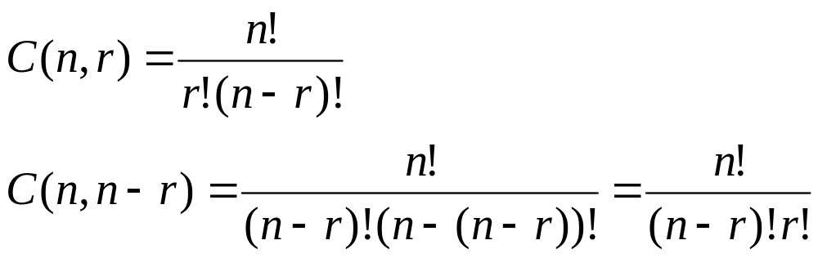
Corollary 2
Let n and r be nonnegative integers with r≤n. Then C(n,r)=C(n,n-r)
Proof:

Slide 19

Combinatorial proof
A combinatorial proof of an identity is a proof that uses counting arguments to prove that both sides of the identity count the same objects but in different ways
Proof of Corollary 2: Suppose that S is a set with n elements. Every subset A of S with r elements corresponds to a subset of S with n-r elements, i.e., . Thus, C(n,r)=C(n,n-r)

Slide 20
Example
How many ways are there to select 5 players from a 10-member tennis team?
Choose 5 out of 10 elements, i.e., C(10, 5)=10!/(5!5!)=252
How many bit strings of length n contain exactly r 1s?
This is equivalent to choose r elements from n elements, i.e., C(n,r)

Slide 21
6.4 Binomial coefficients
The number of r-combinations form a set with n elements is often denoted by
Also called as a binomial coefficient as these numbers occur as coefficients in the expansion of powers of binomial expressions such as (a+b)^{n}
A binomial expression is simply the sum of two terms, such as x+y

Slide 22
Example
The expansion of (x+y)³ can be found using combinational reasoning instead of multiplying the there terms out
When (x+y)³=(x+y)(x+y)(x+y) is expanded, all products of a term in the 1st sum, a term in the 2nd sum, and a term in the 3rd sum are added, e.g., x³, x²y, xy², and y³
To obtain a term of the form x³, an x must be chosen in each of the sums, and this can be done in only one way. Thus, the x³ term in the product has a coefficient of 1

Slide 23


Example
To obtain a term of the form x²y, an x must be chosen in 2 of the 3 sums (and consequently a y in the other sum). Hence, the number of such terms is the number of 2-combinations of 3 objects, namely,
Similarly, the number of terms of the form xy² is the number of ways to pick 1 of the 3 sums to obtain an x (and consequently take a y from each of the other two sums), which can be done in ways

Slide 24
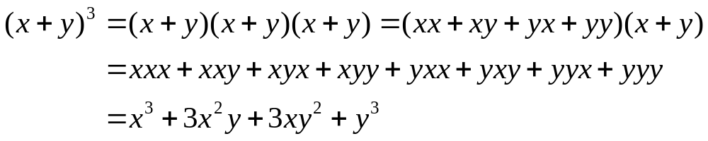
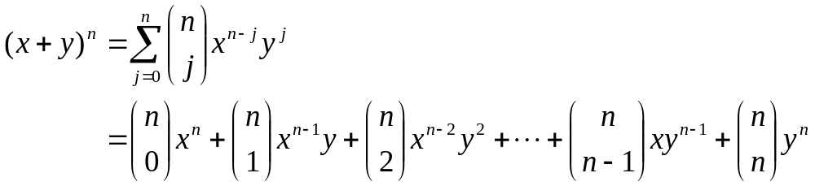
Example
Consequently,
The binomial theorem: Let x and y be variables, and let n be a nonnegative integer

Slide 25
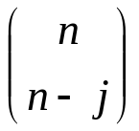

Binomial theorem
Proof: A combinatorial proof of the theorem is given. The terms in the product when it is expanded are of the form x^{n-j}y^{j} for j=0,1,2…, n
To count the number of terms of the form x^{n-j}y^{j} , note that to obtain such a term it is necessary to choose n-j x’s from the n sums (so that the other j terms in the product are y’s). Therefore, the coefficients of x^{n-j}y^{j} is which is equal to

Slide 26
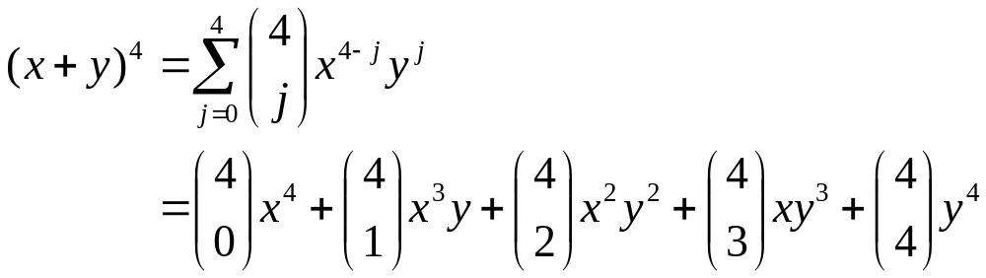
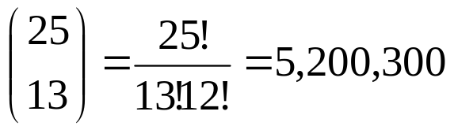
Example
What is the coefficient of x¹²y¹³ in the expansion of (x+y)²⁵?

Slide 27
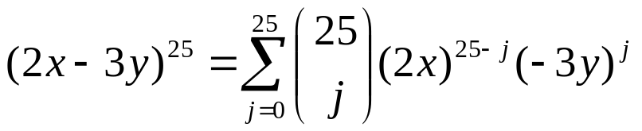
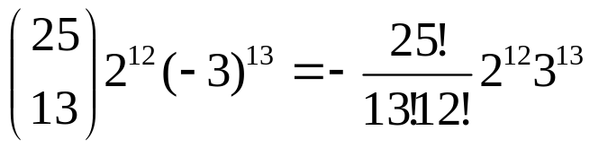
Example
What is the coefficient of x¹²y¹³ in the expansion of (2x-3y)²⁵?
Consequently, the coefficient of x¹²y¹³ is

Slide 28
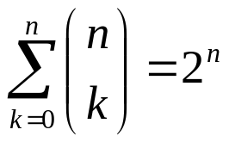
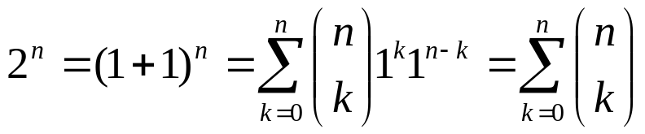
Corollary
Corollary 1: Let n be a nonnegative integer. Then
Proof: Using Binomial theorem with x=1 and y=1

Slide 29



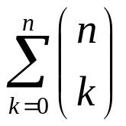
Corollary
There is also a combinatorial proof of Corollary 1
Proof: A set with n elements has a total of 2^{n} different subsets. Each subset has 0 elements, 1 element, 2 elements, or n elements in it. Thus, there are subsets with 0 elements, subsets with 1 element, … and subsets with n elements. Thus counts the total number of subsets of a set with n elements,
This shows that

Slide 30
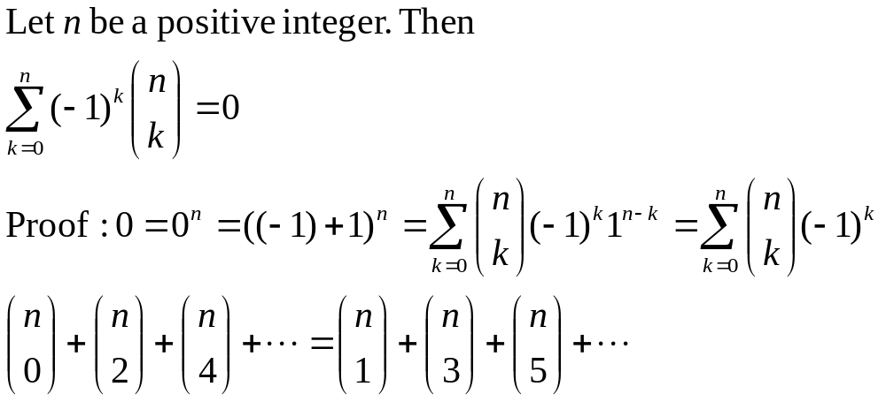
Corollary 2

Slide 31
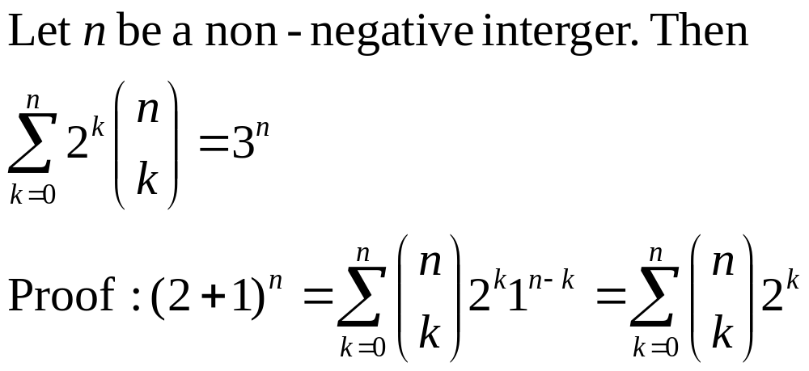
Corollary 3

Slide 32
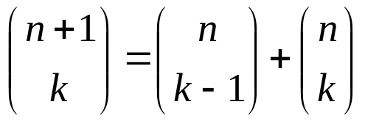
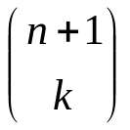
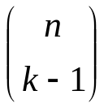

Pascal identity and triangle
Pascal’s identity: Let n and k be positive integers with n ≥ k. Then
Combinatorial proof: Let T be a set containing n+1 elements. Let a be an element in T, and let S=T-{a} (S has n elements)
Note that there are subsets of T containing k elements. However, a subset of T with k elements either contains a (i.e., a subset of k-1 elements of S) or not.
There are subsets of k-1 elements of S, and so there are
subsets of k-1 elements containing a
There are subsets of k elements of T that do not contain a
Thus

Slide 33

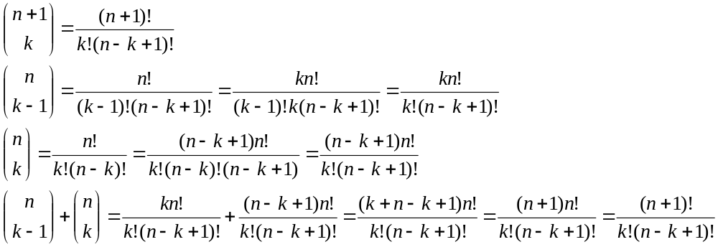
Pascal identity and triangle
Can also prove the Pascal identity with algebraic manipulation of

Slide 34
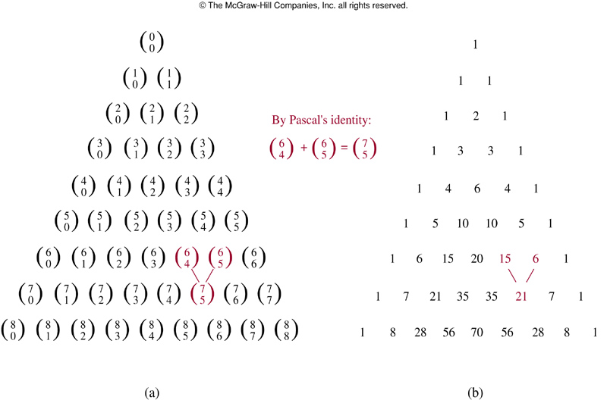
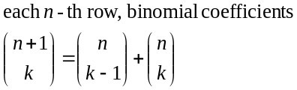
Pascal’s triangle
Pascal’s identity is the basis for a geometric arrangement of the binomial coefficients in a triangle

